Slide 1


Towards the Transparent Execution of Compound OpenCL Computations in Multi-CPU/Multi-GPU Environments
Fábio Soldado, Fernando Alexandre, Hervé Paulino
CITI/Computer Science Department
Faculty of Science and Technology
NOVA University of Lisbon
HeteroPar 2014 @ Euro-Par 2014
Porto, Portugal
August 25

Slide 2
Motivation
Current computational systems are heterogeneous by nature: CPUs + GPUs
The GPU is increasingly being used in general purpose computing
The programming and execution models for CPUs and GPUs are quite different
  Programmer forced to direct the computation to one kind of processing unit
High-level programming of multiple GPUs + multiple CPUs environments as a whole
Notes:
Our motivation arised from the dificulty of programming cpu + gpu
These archs are the current standard – gpu has steadily established itself as an valid alternative for data intensive coputations

Slide 3
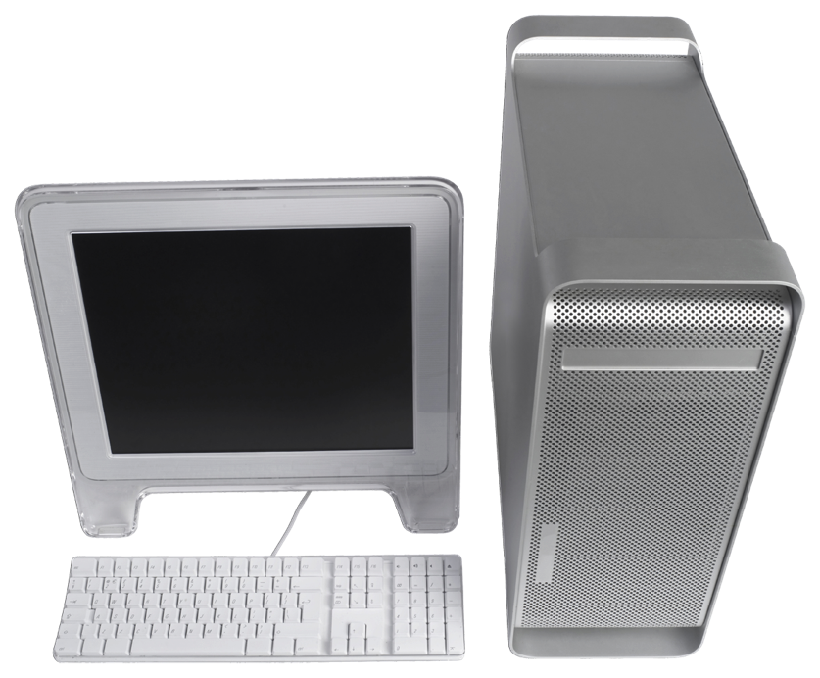
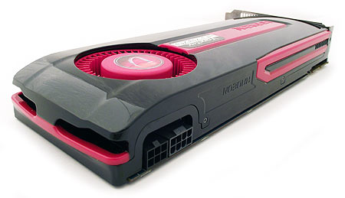
Problem
OpenCL provides code but not performance portability
Low-level programming model – no composition support
Host
Device
Resource management
Orchestration of data transfer and execution requests
SPMD programming model
Memory organization
Bus

Slide 4
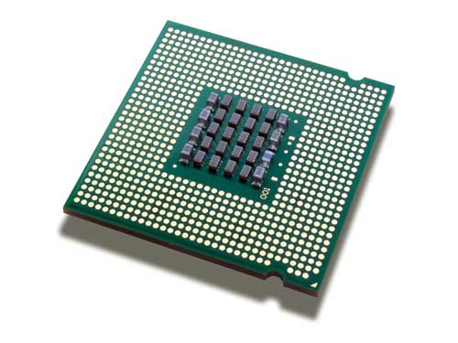
Problem
OpenCL provides code but not performance portability
Low-level programming model – no composition support
Host
Devices
Resource management
Orchestration of data transfer and execution requests
Decompose the computation among the CPUs and GPUs
Scheduling and load balancing
Device-type specific optimizations
SPMD programming model
Device-type specific memory organization
Algorithmic
Skeletons
Bus

Slide 5
The Marrow Framework
Distinguishing Features
C++ algorithmic skeleton framework for the orchestration of OpenCL computations [Euro-Par 2013]
Task and Data-parallel skeletons
  Task-parallel: Pipeline and Loop
  Data-parallel: Map(Reduce)
Skeleton nesting
GPU heterogeneity support
GPU-directed optimizations

Slide 6
The Marrow Framework
Programming Example
Fast Fourier Transform (FFT) pipeline
  Adapted from the SHOC benchmark suite
  FFT kernel → Inverse FFT kernel
iFFT
FFT
Pipeline
Executable pipeline (new Pipeline(FFT, iFFT));
Executable FFT (new KernelWrapper(kernelFile,
kernelFunction, inInfo, outInfo));
new Buffer<cl_float2>()

Slide 7
Proposal
Support the execution of compound OpenCL computations in multi-CPU/multi-GPU environments
Grow the Marrow algorithmic skeleton framework
Transparently
  Distribute the load of a Marrow computations across multiple CPUs and GPUs
  Adapt this distribution to different input data-sets and to the CPUs’ load fluctuations.
Multiple (possibly heterogeneous) GPUs
+ Multiple CPUs

Slide 8
Challenges
How to efficiently decompose a Marrow Computation Tree (CT) among the multiple CPU and GPU devices
How to efficiently distribute the work load among the available hardware resources
How to adapt this distribution to different input data-sets and to the CPUs’ load fluctuations
How to integrate these concepts in the programming model in a non-intrusive way

Slide 9
CT Decomposition
Replicating the skeleton tree
Input dataset
Integrates seamlessly with the SPMD model
Avoids data migration between devices
Scales well with the increase of devices
Locality-aware domain decomposition
iFFT
FFT
Pipeline
iFFT
FFT
Pipeline

Slide 10
CT Decomposition
OpenCL Fission
Fission of 2
Sub CPU
Sub CPU
Best Fission level?
Sub CPU
Sub CPU
Data
Overlap Partition
Overlap Partition
Overlap Partition
Overlap
Comp/Comm
Factor of 3
Best overlap factor?
Overlap Partition
Overlap Partition
Overlap Partition

Slide 11
CT Decomposition
Evenly distributed
Sub CPU
Sub CPU
f
Best Fission level?
Sub CPU
Sub CPU
f?
Data
ata
Overlap Partition
Overlap Partition
Overlap Partition
1-f
Best overlap factor?
Overlap Partition
Distributed according to the relative performance of the devices [SAC 2014]
Overlap Partition
Overlap Partition

Slide 12
Work Distribution – CPUs +GPUs
We are particularly interested in recurrent applications of CTs upon possibly different data-sets with different sizes
Lightweight mechanism to derive a suitable configuration for a CT’s execution, given a particular parameterization
→ Profile-based self-adaptation
  Resort to a profile built from a past executions
  and to the current CPU load information

Slide 13
Work Distribution – CPUs +GPUs
Decision Process
Execution request
New CT?
CT info?
Train flag?
yes
yes
no
yes
Perform training
Persist result
Monitored execution
Compute lbt

Slide 14
Work Distribution – CPUs +GPUs
Training Process
Dimensions to consider
  Fission level
  Overlap factor
Compute the best workload distribution (f) for each considered fission/overlap configuration
  Two approaches:
    50/50 split
    CPU assisted GPU execution
  Final result: the best overall performance
Uniform search over the search space (to improve)

Slide 15
Work Distribution – CPUs +GPUs
Decision Process
Execution request
NewCT?
CT info?
Train flag?
yes
yes
no
Derive configuration
Persist result
Monitored execution
Compute lbt

Slide 16
Distribution Adaptation
Derive an initial work distribution
  Interpolation from past executions → Nearest-neighbor

Slide 17
Work Distribution – CPUs +GPUs
Decision Process
Execution request
NewCT?
CT info?
Train flag?
yes
yes
no
Derive configuration
no
New data-set?
yes
Persist result
Monitored execution
Compute lbt
no
Must rebalnce?
Retrieve lbt
no
Adjust distribution
yes

Slide 18
Distribution Adaptation
Derive an initial work distribution
  Interpolation from past executions – Nearest-neighbor
Adjust work distribution
  When lbt(t) ≈ 1
  Two-level approach
    Transfer load from the worst performing computing unit type to the best performing
    Retrigger the process to find the best configuration for the current fission/overlap configuration

Slide 19
Evaluation
Metrics
Speed-up relatively to GPU-only executions
Efficiency of the work distribution strategy
Efficiency load balancing strategy

Slide 20
Evaluation
Case Studies and Test Platforms
Case Studies
Image Filter Pipeline: 3 stage pipeline
FFT (Fast-Fourier Transformation): 2 stage pipeline
N-Body (Direct-sum, O(N²)): For loop
Saxpy: Map
Segmentation: Map
Test Platform
CPU
  Intel Core i7-3930K @ 3.20 GHz
    6 cores → 12 hardware threads
  6 L1 and L2 caches
  1 L3 cache
GPUs
  2 AMD HD 7950 (2x PCIe bus)
Notes:
Falar de como estão decompostos

Slide 21
Evaluation - Speedup
1 GPU + CPU vs 1 GPU
50/50 split
CPU assisted GPU execution
Notes:
Compara, atraves do speedup, execuções só...
Speedups sugnificativos
Apesar de algumas diferenças de performances em alguns benchmarks....
Explicar nbody

Slide 22
Evaluation - Speedup
2 GPUs + CPU vs 2 GPUs
50/50 split
CPU assisted GPU execution
Notes:
Compara, atraves do speedup, execuções só...
Speedups sugnificativos
Apesar de algumas diferenças de performances em alguns benchmarks....
Explicar nbody

Slide 23
Evaluation – Config. Derivation
Fraction assigned to the GPUs
Execution time

Slide 24
Evaluation – Load Balancing

Slide 25
Conclusions
We are able to support the execution of
  Nestable task-parallel skeletons in heterogeneous multi-CPU / multi-GPU environments
  With device specific-optimizations
    CPU – locality via Fission
    GPU – overlap of communication and computation
  Transparent work distribution and load balancing in the presence of recurrent executions
The experimental results are promising
The program size is reduced more than 5x for a simple map example (Saxpy)

Slide 26
Future Work
Regarding CPU + GPU
  Optimize configuration derivation
  Conjoin the use of profiling with performance models
Regarding Marrow
  Other types of accelerators
  Cluster of multi-CPU / multi-GPU nodes
  Generate code for kernels and orchestration from higher-level representations
  More skeletons

Slide 27
Questions?

Slide 28
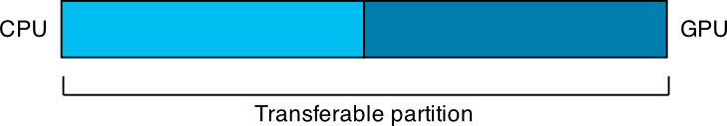


Work Distribution – CPUs +GPUs
50/50 Split

Slide 29
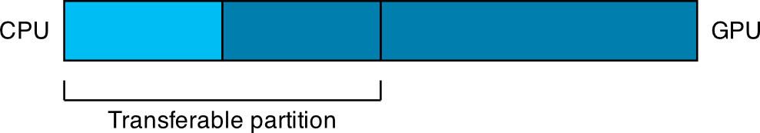
Work Distribution – CPUs +GPUs
50/50 Split

Slide 30
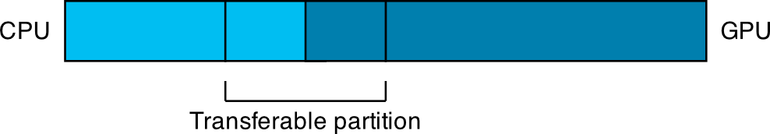
Work Distribution – CPUs +GPUs
50/50 Split

Slide 31
Execução só com CPUs
Notes:
Fission compensa sempre
Arquitectura Numa pode influênciar

Slide 32
Treino FFT 256 Mb
Notes:
Performance medida durante a caracterização
Diferença entre fission e sem fission é bastante notável (NUMA)
Dentro das execuções com fission, os resultados são diferentes

Slide 33
Online Monitoring
Notes:
Isto vai permitir caracterizar a execuçao como balanceada...
Ou desbalanceada se houver uma diferente significante

Slide 34
Evaluation
Distribution Quality
Notes:
Meter max 2.0

Slide 35
Evaluation
Productivity – Lines of code
Saxpy: Z[i] = alpha * X[i] + Y[i]
 | Initialization/Finalization | Orquestration | Total
OpenCL | 104 | 94 | 198
Marrow | 18 | 38 | 56
Reduction | 5.7x | 2.5x | 3.5x

Slide 36
Decomposing Marrow Computations
The Loop Skeleton
Upload/Update partition to GPU #1
Body
Download
data to host
Update loop state
Evaluate condition on the host
True
False
Upload/Update partition to GPU #N
Body
Download
data to host
Update loop state
Evaluate condition on the host
True
False

Slide 37
Programming Interface
New Features
Control over
  What may and may not be partitioned
    PARTITIONABLE
    COPY
  The elementary size of a partition
Merge functions

Slide 38
Programming Example
FFT Pipeline Revisited
iFFT
FFT
Pipeline
unique_ptr<Executable> pipeline (new Pipeline(FFT, iFFT));
unique_ptr<Executable> FFT (new KernelWrapper(kernelFile,
kernelFunction, inInfo, outInfo));
Partition
elementary
size
shared_ptr<IWorkData> (new BufferData<cl_float2>());
shared_ptr<IWorkData> (new BufferData<cl_float2>(fftSize,
IWorkData::PARTITIONABLE));

