Slide 1
Non-linear iterative optimization method
for locating particles using HPC techniques
G. Ortega¹, J. Lobera², I. García³, M. P. Arroyo² and E. M. Garzón¹
¹Dpt. Computer Architecture and Electronics. University of Almería
²Aragón Institute of Engineering Research (I3A). University of Zaragoza
³Dpt. Computer Architecture. University of Málaga
Heteropar 2014

Slide 2
Outline
Introduction
Non-Linear ODT model for locating particles (NLODT-P)
Methodology to develop models
GPU computing (Forward procedure)
Validation of NLODT-P
Evaluation of NLODT-P
Conclusions

Slide 3
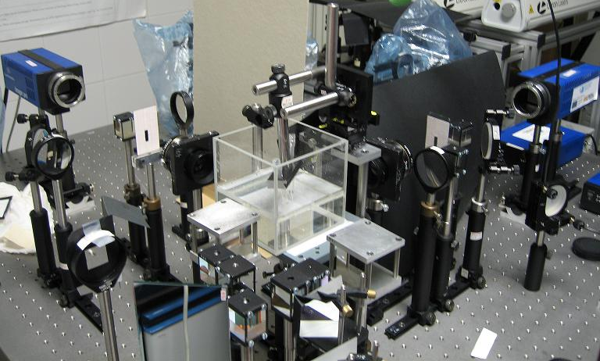
Optical Diffraction Tomography (ODT)
ODT characteristics:
ODT has been recently introduced in several fields.
High accuracy with non-damaging radiation and its imaging capability to recover information from the object.

Slide 4
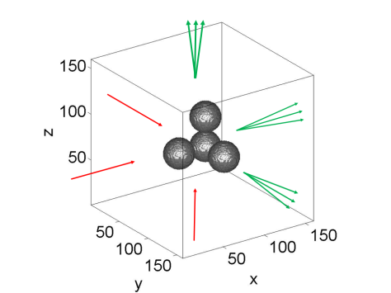
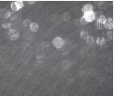
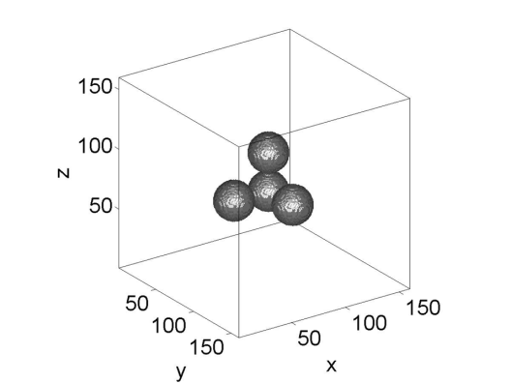
Optical Diffraction Tomography (ODT)
2D holograms
Laser
ODT techniques

Slide 5
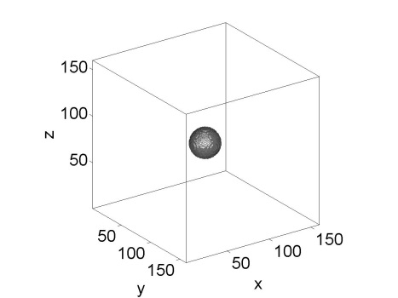
Optical Diffraction Tomography (ODT)
INPUTS
2D holograms
A priori
information
Diameter of the particles
Refractive index of particles
Fluid refractive index
Laser
ODT techniques
OUTPUT
Set of seeding particle locations

Slide 6
Optical Diffraction Tomography (ODT)
NLODT→ Preliminary model 2D (proposed by J. Lobera and J.M. Coupland)→ High computational cost.
The resolution of large and sparse linear systems of equations of complex numbers in double precision was required.
Linear Optical Diffraction Tomography (LODT)
Non Linear Optical Diffraction Tomography (NLODT)
Overcome the problems of multiple scattering in LODT
High fidelity images
Implementation and validation of a 3D NLODT model for the location of particles

Slide 7
Non-Linear ODT model for locating particles (NLODT-P)
Helmholtz equation :
$\left(∇2+{k0}_{}^{2}n\left(r\right)\right)Es(r)=f\left(r\right)Er(r)$ where $f\left((n\left(r\right))\right)=−{k0}_{}^{2}(n2\left(r\right)−1)$
E_{r} (r)→ illuminating field.
E_{s} (r) → Scattering field.
n (r) → Refractive index of the object to reconstruct.
f (r) →Scattering potential.
Reconstruction problem → Optimization problem
$$\text{cost} \left(f(n(r))\right)=\sum_{i}{{|Em}_{}^{i}}\left(r\right)−{Ec}_{}^{i}(f, r)|2$$
Estimation
of n(r)
Optimization
Method CG
$$g\left(r\right)∗=\sum_{i}{{Em}_{}^{i}}\left(r\right)∗{Er}_{}^{i}(r)$$
$$\max\left|g\left(r\right)∗\right|=Position of the particle$$

Slide 8
Non-Linear ODT model for locating particles (NLODT-P)
1: Compute PL(1)
2: It = 2
3: while It < iterMax and Value < threshold do
4: Update n(r)
5: for i = 1, 2, ... until i < Nh do
6: E^{i}_{s}(r) = Forward (E^{i}_{r}(r), n(r))
7: E^{i}_{r,n}(r) = E^{i}_{s}(r) + E^{i}_{r}(r)
8: E^{i}_{c}(r) = Filter (E^{i}_{s}(r), k^{i}₀,NA)
9: E^{i}_{m,n}(r) = Forward ((E^{i}_{c}(r) − E^{i}_{m}(r))∗, n(r))
10: E^{i}_{m,n}(r) = E^{i}_{m,n}(r) + (E^{i}_{c}(r) − E^{i}_{m}(r))∗
11: g(r)∗ = g(r)∗ + (E^{i}_{m,n}(r), E^{i}_{r,n}(r))
12: end for
13: gMF (r) = Matched Filtering(g(r), sample)
14: [PL(It), Value] = max(abs(gMF (r)))
15: It = It + 1
16: end
Location of the
1st particle
Initial Iteration
Update the refractive
index field
Compute the
updated gradient, g(r)
Iterative
Process
Locate next particle

Slide 9
Non-Linear ODT model for locating particles (NLODT-P)
1: Compute PL(1)
2: It = 2
3: while It < iterMax and Value < threshold do
4: Update n(r)
5: for i = 1, 2, ... until i < Nh do
6: E^{i}_{s}(r) = Forward (E^{i}_{r}(r), n(r))
7: E^{i}_{r,n}(r) = E^{i}_{s}(r) + E^{i}_{r}(r)
8: E^{i}_{c}(r) = Filter (E^{i}_{s}(r), k^{i}₀,NA)
9: E^{i}_{m,n}(r) = Forward ((E^{i}_{c}(r) − E^{i}_{m}(r))∗, n(r))
10: E^{i}_{m,n}(r) = E^{i}_{m,n}(r) + (E^{i}_{c}(r) − E^{i}_{m}(r))∗
11: g(r)∗ = g(r)∗ + (E^{i}_{m,n}(r), E^{i}_{r,n}(r))
12: end for
13: gMF (r) = Matched Filtering(g(r), sample)
14: [PL(It), Value] = max(abs(gMF (r)))
15: It = It + 1
16: end
Initial Iteration
Resolution Helmholtz equation
Resolution Helmholtz equation
Iterative
Process
95% Runtime

Slide 10
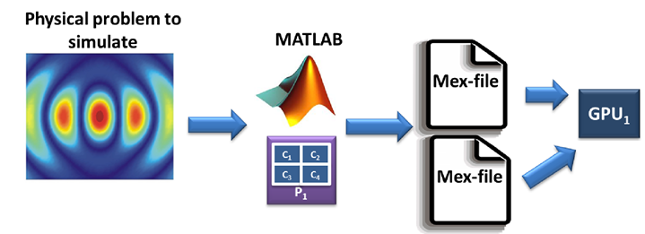
Methodology to develop models (MATLAB + GPU computing)
Multithreaded
High programming language level
Visualization tools
Libraries: GPUmat, Jacket, Mexfiles
Accelerate procedures with high computational cost: Forward (Helmholtz equation)

Slide 11
GPU computing (Forward procedure)
Linear Eliptic Partial
Differential of
Equations (PDE)
$$(∇^{2}\left(r\right)+{k(r)}^{2}) E\left(r\right)=0$$
Green’s Functions
Spatial Discretization (based on FEM)
Large linear system of equations
M is sparse, symmetric and with a
regular pattern
$$Mx=b$$
Biconjugate Gradient Method (BCG)
11

Slide 12
GPU computing (Forward procedure)
Biconjugate Gradient Method (BCG)
dots
saxpy
SpMV
Regular Format

Slide 13
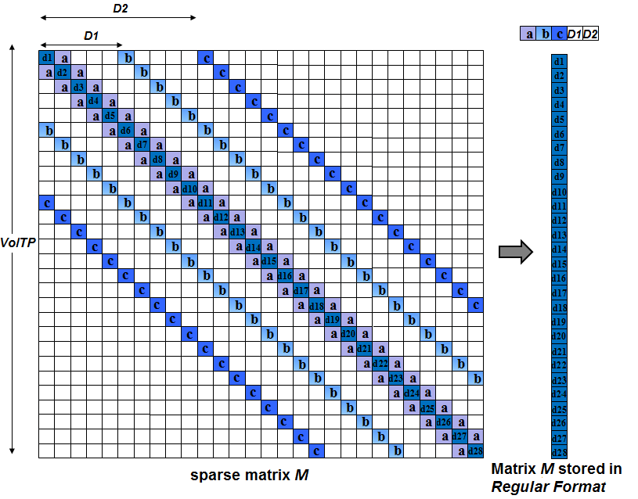
GPU computing (Forward procedure)
Regularities of M
Complex symmetric matrix
Max 7 nonzeros/row
Nonzeros are located by 7 diagonals
Same values for lateral diagonals (a, b, c)
Mem. Req. (GB) for storing M:
VolTP CRS ELLR-T Reg Format
160³ 0.55 0.44 0.06
640³ 35.14 28.33 3.91
1600³ 549.22 442.57 61.04

Slide 14
GPU computing (Forward procedure)
CUDA interface.
CUBLAS library for saxpy and dot operations.
Optimization techniques:
The reading of the sparse matrix and data involved in vector operations are coalesced global memory access, this way the bandwidth of global memory is maximized.
Shared memory and registers are used to store any intermediate data.

Slide 15
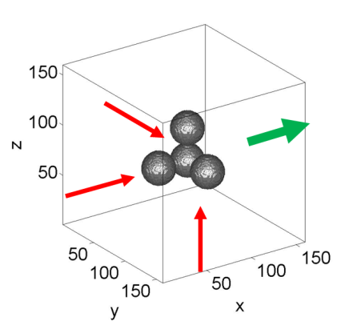
Validation of NLODT-P
4 particles of 2µm
λ= 0.633µm
NA = 0.55
Vol= 160³
N_{h} = 1
A PRIORI INFORMATION:
Diameter of the particles
Refractive index of particles
Fluid refractive index
Volume to reconstruct

Slide 16
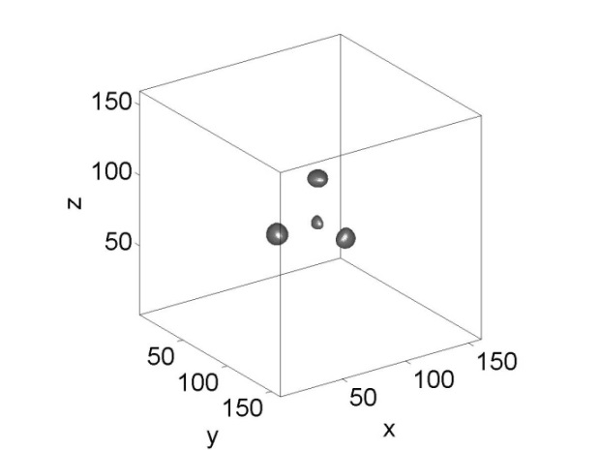
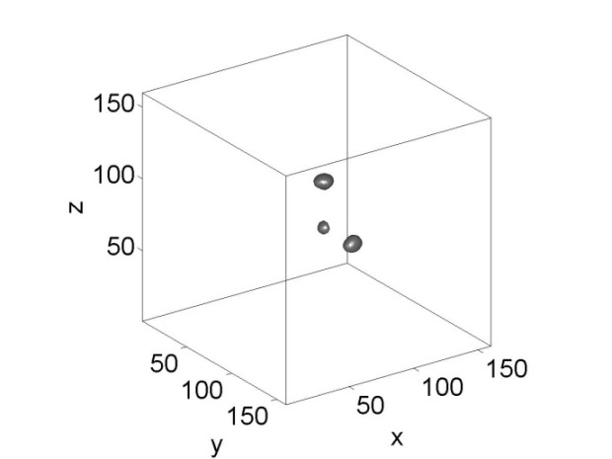
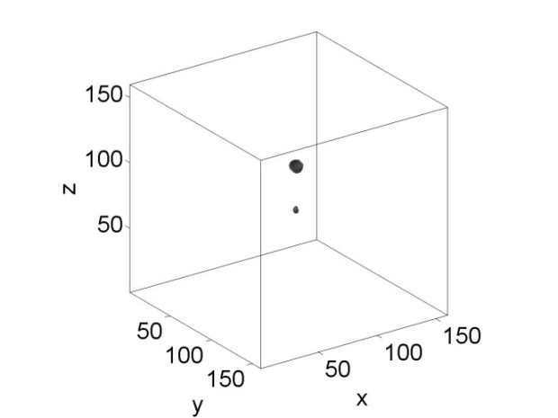
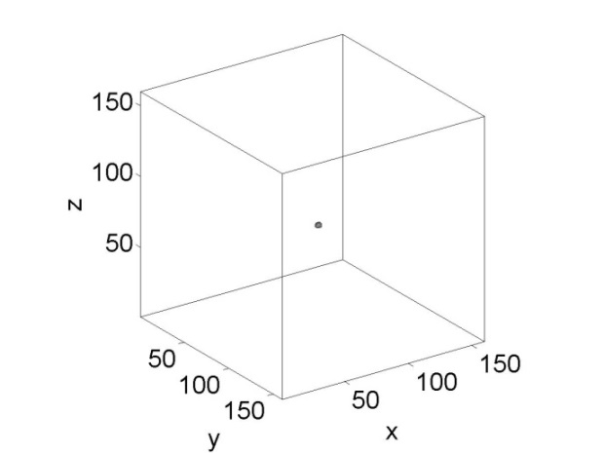
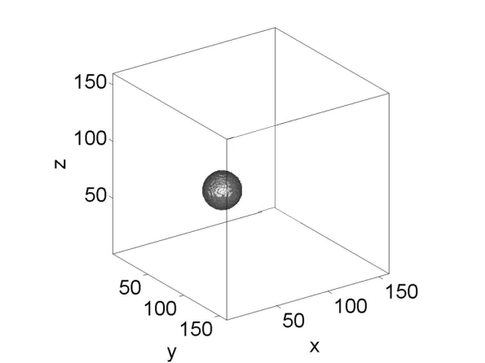
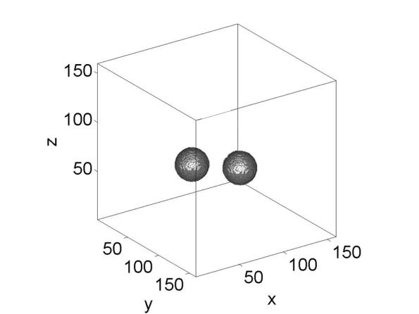
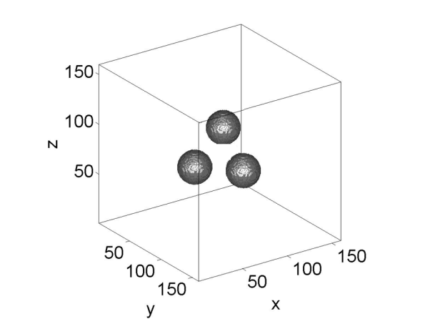
Validation of NLODT-P
1ª iteration
2ª iteration
3ª iteration
4ª iteration
Evolution of the gradient of the cost function, g(r)
Evolution of the distribution of the refractive index, n(r)

Slide 17
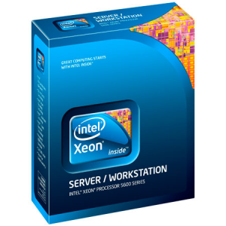
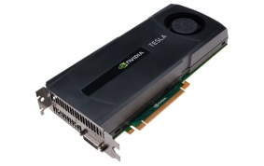
Evaluation of NLODT-P
GPU architecture (CUDA programming interface)
Multicore: Intel Xeon E5620 (8 cores)
(2.4 GHz, 48 GB RAM) under Linux.
 | Tesla M2090
Peak performance (double precision) (GFlops) | 665
Peak performance (simple precision) (GFlops) | 1331
Device memory (GB) | 6
Clock rate (GHz) | 1.3
Memory bandwidth (GBytes/sec ) | 177
Multiprocessors | 16
CUDA cores | 512
Compute Capability | 2
Year architecture | 2011
DRAM TYPE | GDDR5

Slide 18
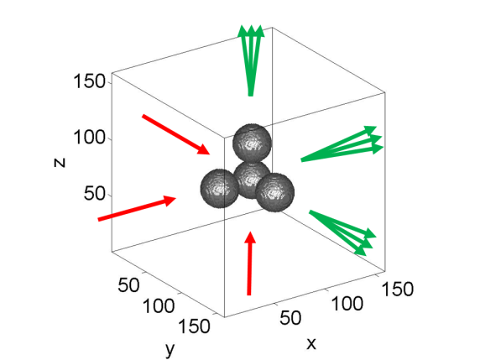
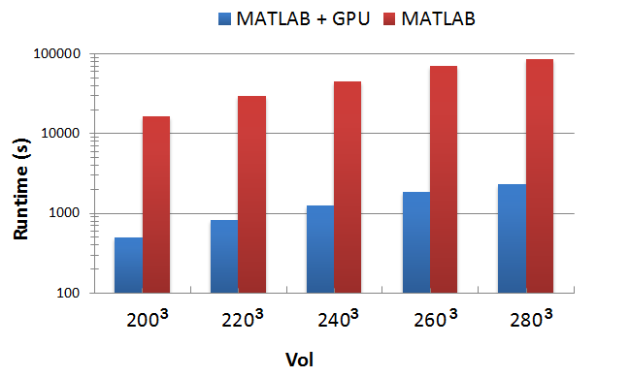
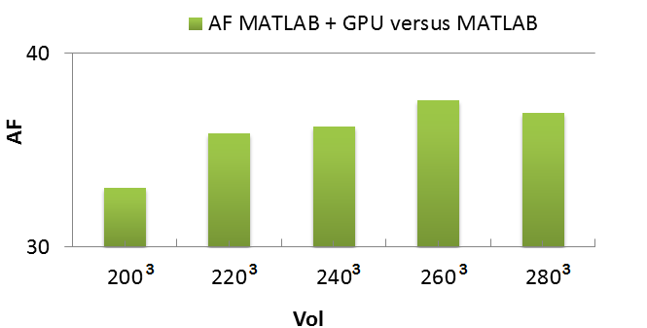
Evaluation of NLODT-P
4 particles of 0.5µm
λ= 0.633µm
NA = 0.55
Vol= 200³⁻280³
N_{h} = 3
iterMax=4

Slide 19
Conclusions
A physical model of Non-linear ODT for the application in velocimetry techniques has been implemented and evaluated over 3D prototypes of interest (NLODT-P).
MATLAB framework → productivity in the generation of codes.
Integration of GPU computing and MATLAB → Mex-files.
Illustration of a methodology for the development of scientific applications.
GPU memory is a limiting factor.
Future works: distributed implementation.

Slide 20
Conclusions
Distributed version of Forward
MultiGPU Implementation
Multicore CPU Implementation
+
CUDA
Message Passing Interface (MPI)
Hybrid Implementation (BCG-3DH)
Solve larger problems
Runtime is reduced

Slide 21
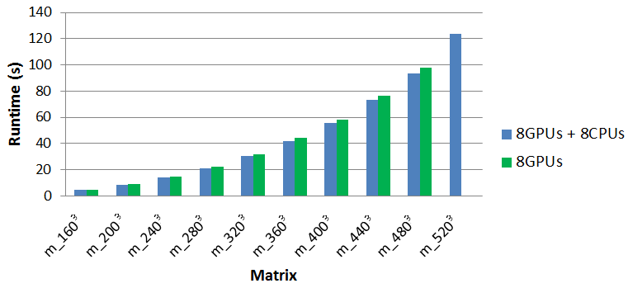
Conclusions
Runtime (s) of 1000 iterations of the BCG-3DH using
8GPUs+8CPUs versus 8GPUs
Vol

Slide 22
Contraportada

